Slide 1
Prenatal diagnostic procedures

Slide 2
Main indications for prenatal cytogenetic diagnosis:
the pregnant woman being of older childbearing age
parental heterozygosity for a chromosome rearrangement
(3) the birth of a previous child with a chromosome defect
(4) increased risk on maternal screening test
(5) fetal anomaly detected on ultrasonography

Slide 3
Analytical procedures used to detect common aneuploidies in prenatal testing:
Classical cytogenetics (slow)
Faster return of results:
FISH
QF-PCR
MLPA
Microarray

Slide 4
Laboratory (molecular) prenatal diagnostic procedures
Fluorescence in situ hybridization
Using multiple colored probes and targeting chromosomes most prone to survivable aneuploidy (13, 18, 21, X, and Y) bypasses need for culture, whether cells are from amniotic fluid or CVS, and result can be given within space of one working day
Focused FISH can be applied in specific circumstances:
The ultrasound discovery of a cardiac abnormality would, for example, point to the need for 22q11 analysis
A rapid diagnosis is particularly to be desired in the setting of parental heterozygosity for a chromosome rearrangement
FISH tests only that segment of the chromosome to which the probe binds. Inferentially, the complete chromosome is present; but this is not necessarily so

Slide 5
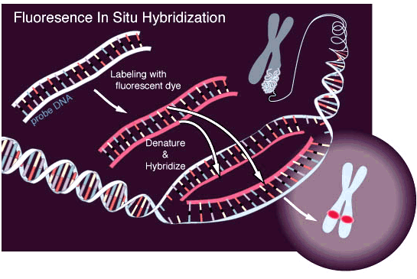

Slide 6
Quantitative fluorescence polymerase chain reaction
QF-PCR relies on use of molecular markers that display high level of heterozygosity, such that presence of three alleles—that is, a trisomy— can reliably be detected
Similarly to FISH, when compared to karyotyping, QF-PCR has advantages of:
lower cost
shorter turnaround of results
lower technical complexity
The major disadvantage is that QF-PCR will only identify common aneuploidies: Most deletions and duplications, along with balanced rearrangements, will not be detected

Slide 7
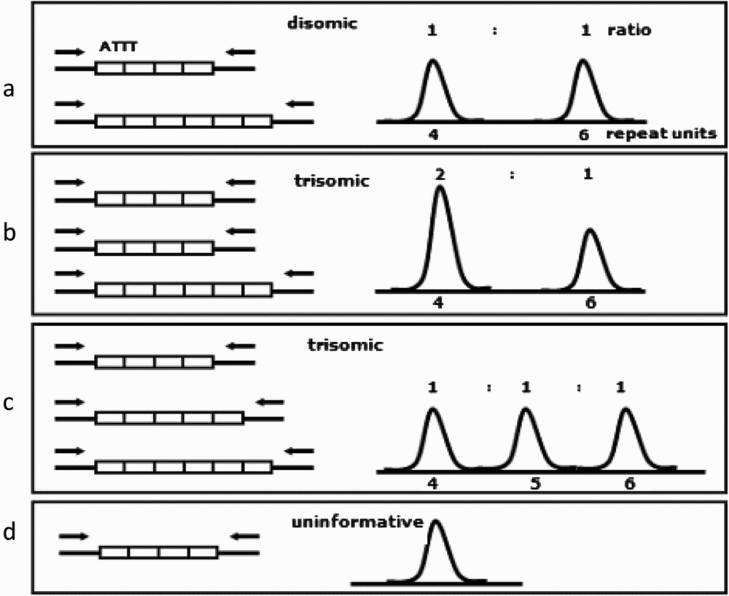
Sequences assessed are chromosome-specific polymorphic small tandem repeats. Three allelic forms of a particular marker allows the assumption of trisomy for that chromosome

Slide 8
Multiplex ligation-dependent probe analysis
MLPA is a PCR-based assay that can combine probes to many chromosomal loci, has a short turnaround time
A targeted application enables the diagnosis of microdeletion syndromes that would otherwise have escaped detection

Slide 9
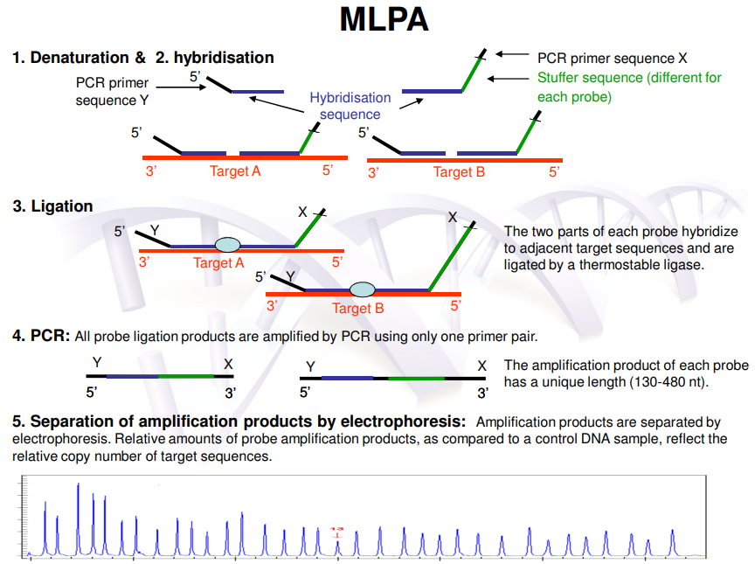

Slide 10
Microarray analysis
Microarray analysis can be applied to CVS and amniocentesis samples, with or without prior culture. Results can be delivered within several days
A possible drawback is that microarrays can show copy number variants (CNVs), which may introduce an uncertainty into the diagnostic interpretation

Slide 11
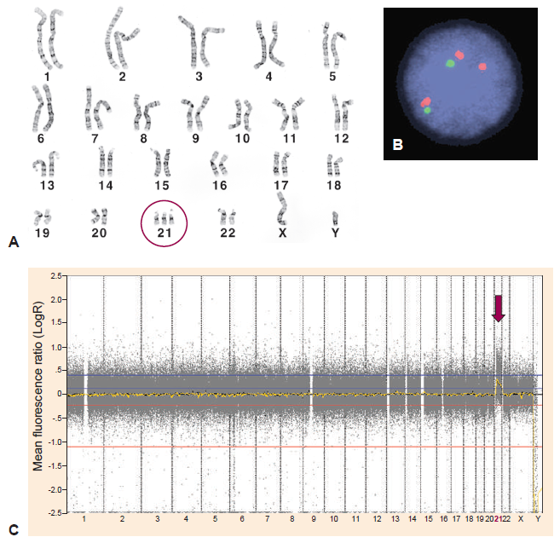
Chromosomal and genomic approaches to the diagnosis of trisomy 21.
A, Karyotype from a male patient with Down syndrome, showing three copies of chromosome 21. B, Interphase FISH analysis using locus-specific probes from chromosome 21 (red, three spots) and from a control autosome (green, two spots).
C, Detection of trisomy 21 in a female patient by whole-genome chromosomal microarray. Increase in fluorescence ratio for sequences from chromosome 21 are indicated by red arrow.

Slide 12
Clinical prenatal diagnostic procedures
Chorionic Villus Sampling
CVS is typically a first trimester procedure, usual time being at 10–11 weeks gestation
Transabdominal needle insertion through placental tissue under ultrasound guidance and aspiration of a chorionic villus tissue
Earlier period of diagnosis permitted by CVS, compared with amniocentesis, may be seen as more useful in the setting of a higher genetic risk

Slide 13
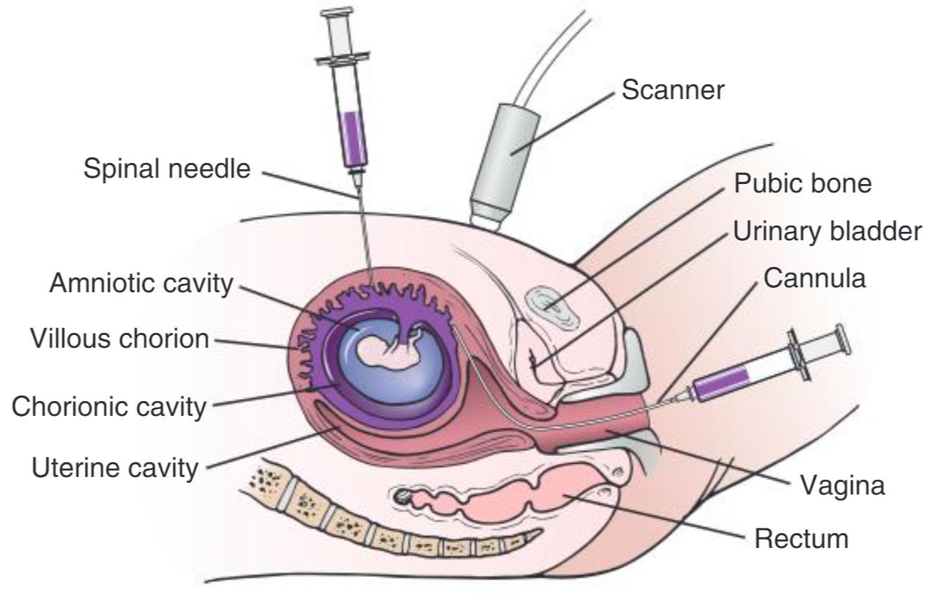
Chorionic Villus Sampling
Two alternative approaches are drawn:
Transcervical (by means of a flexible cannula)
Transabdominal (with a spinal needle)
Success and safety depend o fuse of ultrasound imaging

Slide 14
There is potential in CVS for diagnostic difficulty due to the occasional detection of confined placental mosaicism
Risk of procedure-related miscarriage in women who had undergone CVS was only 0.22% (approximately 1 in 500 procedures)
CVS earlier than 10 weeks is associated with increased health risks for the child, thus it is not done earlier than 10 weeks

Slide 15
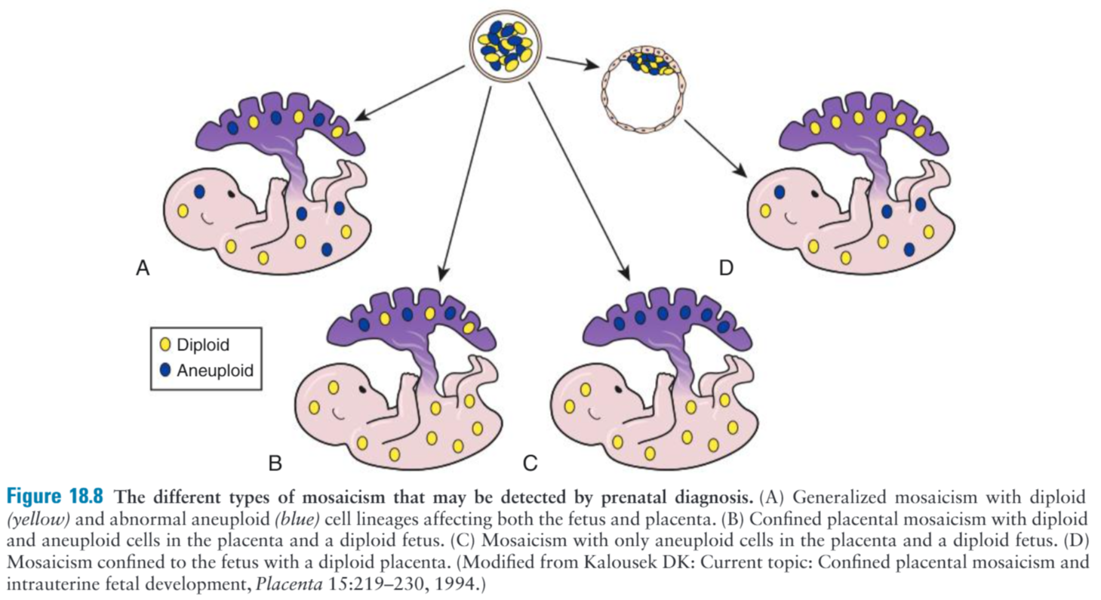

Slide 16
Amniocentesis
Amniocentesis, 15–17 weeks gestation, with culture of cells for chromosome analysis, has been standard cytogenetic prenatal diagnostic procedure since 1970s
Has a high degree of safety to both mother and fetus
Risk of procedure-related miscarriage in women who had undergone amniocentesis was 0.11% (approximately 1 in 1,000 procedures)
A disadvantage of amniocentesis is that results are not to hand until about 16–18 weeks

Slide 17
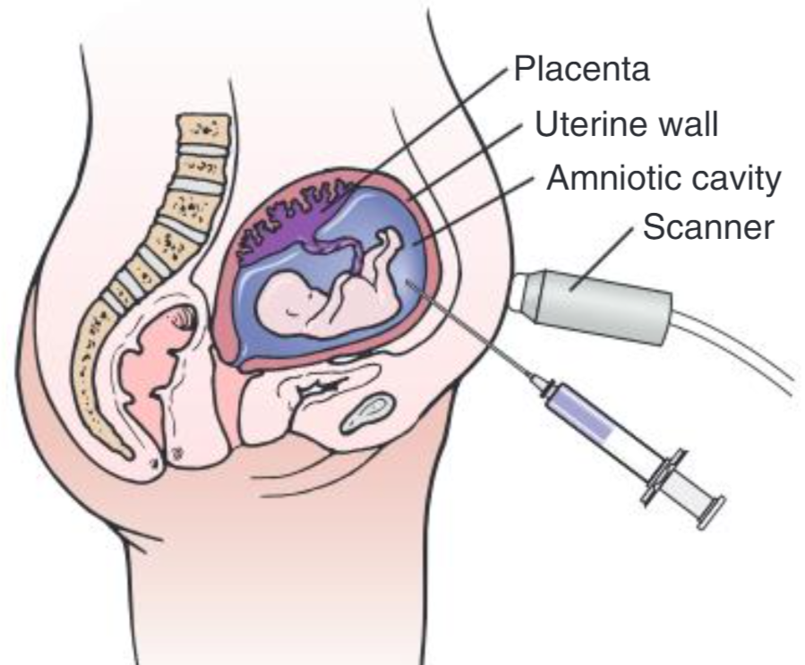
Amniocentesis
A needle is inserted transabdominally into the amniotic cavity, and a sample of amniotic fluid is withdrawn by syringe for diagnostic studies (e.g. chromosome studies, enzyme measurements, or DNA analysis). Success and safety depend on use of ultrasound imaging.

Slide 18
Noninvasive prenatal testing using cell-free DNA from maternal blood
Noninvasive prenatal testing (NIPT) for fetal aneuploidy detection, using cell-free DNA from maternal blood, has been implemented in the clinical setting since 2012
Cell-free DNA (cfDNA) testing takes advantage of the fact that everyone has free DNA circulating in the bloodstream, and in pregnant women, a proportion of that DNA is derived from apoptosing cells of the fetus placenta
The “fetal fraction” of the maternal sample, typically comprises approximately 10% of the whole

Slide 19
